Slide 1



C# Test Preparation
http://telerikacademy.com
Asya Georgieva
QA Trainer
Telerik Software Academy
academy.telerik.com

Slide 2

Introduction to Programming

Slide 3
Question
Indicate the incorrect purpose of the Framework Class Library (FCL)?
Provides functionality for creating console applications
Provides functionality for creating WPF and Silverlight rich-media applications
Provides functionality for creating iOS and Android applications
Provides functionality for creating Windows Forms GUI applications
Provides functionality for creating web applications (dynamic Web sites)

Slide 4

Question
Indicate the incorrect purpose of the Visual Studio IDE?
Edit images
Design user interface
Write code in many languages
Execute / test / debug applications
Browse help and web
Edit excel documents
Manage project's files

Slide 5

Primitive Data Types and Variables

Slide 6
Question
What will the following code result in?
True
False
925
1850
Run-time error
0
Compile time error
char zero = '0';
char one = '1';
char two = '2';
char three = '3';
char four = '4';
char five = '5';
char six = '6';
char seven = '7';
char eight = '8';
char nine = '9';
string ns = (nine + two + five).ToString();
int n = ((nine - '0') * 10 + two - '0')
* 10 + five - '0';
Console.WriteLine(n == ns);

Slide 7
Answer
What will the following code result in?
char zero = '0';
char one = '1';
char two = '2';
char three = '3';
char four = '4';
char five = '5';
char six = '6';
char seven = '7';
char eight = '8';
char nine = '9';
string ns = (nine + two + five).ToString();
int n = ((nine - '0') * 10 + two - '0')
* 10 + five - '0';
Console.WriteLine(n.ToString() == ns);
What will be the result?
int type should be converted to string

Slide 8

Question
What will the following code result in?
16
2
int i = 0x10;
int j = 0x2;
Console.WriteLine(i<<j);
1
2
Run-time error
Compilation error
32
64

Slide 9
Question
What will the following code result in?
string str = @"\\//\""\'\""";
Console.WriteLine(str);
\\//\"\'\"
\//"'"
\/"'"
\\//"'"
\//"'"
\\/"'"
Compilation error
Run-time error

Slide 10
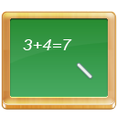
Question
What will the following code result in?
double a = 0.2;
decimal b = 0.3m;
Console.WriteLine(a+b);
0
0.5
null
Compilation error
Run-time error

Slide 11
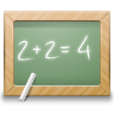
Question
What will the following code result in?
string a = "1";
long b = 1L;
Console.WriteLine(b + a);
11
11L
1L1
2
Compilation error
Run-time error

Slide 12

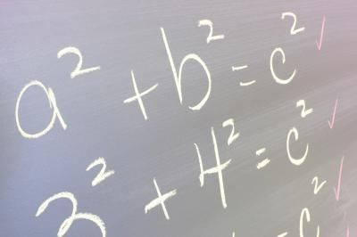
Operators, Expressions and Statements

Slide 13
Question
What will the following code result in?
byte number = 0;
for (int i = 0; i <= 32; i++)
{
number >>= i;
for (int j = 0; j >= -32; j--)
{
number <<= Math.Abs(j);
}
}
Console.WriteLine(number);
0 shifted left/right is always 0
0
1
True
False
2
255
Compilation error
Run-time error

Slide 14
Question
What will the following code result in?
byte b1 = 1;
int i1 = 2;
int result1 = b1 << i1;
int result2 = i1 << b1;
int result3 = (i1 + b1) << (i1 - b1);
Console.WriteLine("{0}, {1}, {2}",
result1, result2, result3);
4, 6, 4
4, 6, 6
6, 6, 4
6, 4, 4
4, 4, 4
4, 4, 6
6, 6, 6
0, 0, 0
1, 1, 1
4, 4, 2

Slide 15
Question
What will the following code result in?
1
0
2147483647
–2147483647
True
False
Compile time error
3.402823E+38
-3.402823E+38
double first = 0.0f;
double second = 0.0;
for (int i = 0; i < 12; i++)
{
first += 0.1;
}
for (int i = 0; i < 4; i++)
{
second += 0.3;
}
Console.WriteLine(first==second);
1.2
1.2

Slide 16
Question
What will the following code result in?
100
True, True, True
True, True, False
True, False, True
True, False, False
False, True, True
False, False, True
False, False, False
False, True, False
Compilation error
Run-time error
110
int n1 = 4;
int n2 = 6;
int n3 = 8;
int result1 = n1 ^ n2 & n3;
int result2 = (n1 ^ n2) & n3;
int result3 = n1 ^ (n2 & n3);
bool equal12 = result1 == result2;
bool equal13 = result1 == result3;
bool equal23 = result2 == result3;
Console.WriteLine("{0}, {1}, {2}", equal12, equal13, equal23);
4
1000
0
4
Bitwise AND has higher priority than bitwise XOR

Slide 17

Question
What will the following code result in?
int a = 3;
int b = 5;
int result = a+++ ++b;
Console.WriteLine("{0} {1} {2}", ++a, b++, --result);
4 6 9
4 5 8
4 6 8
5 6 9
Compilation error
5 5 8
5 6 8
5 7 8
5 7 9

Slide 18
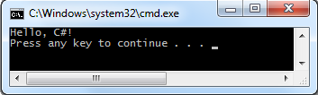
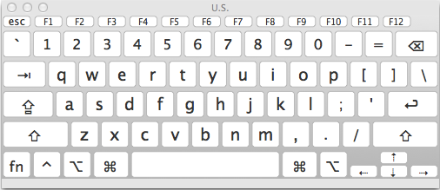
Console Input and Output

Slide 19
Question
Indicate the correct statement for the following line of code?
Console.Write("Full line{0}", 1, 2);
The next print operation will result in a run-time error
The next print operation will start on the same line
This is an invalid method call
This print operation will cause run-time error
This will cause compilation error
There is no Write(…) method in the Console class

Slide 20
Question
Which line of code should be used if we want to ensure that the decimal separator is "."?
Console.OutputEncoding = Encoding.UTF8;
Console.SetDecimalSeparator('.');
Console.DecimalSeparator = '.';
Console.CurrentCulture = CultureInfo.InvariantCulture;
double.Parse(1.2);
Thread.CurrentThread.CurrentCulture = CultureInfo.InvariantCulture;

Slide 21

Question
What will Console.ReadLine() return when there aren't any available lines to read?
""
"\0"
'\0'
null
Compile time error
Run-time error

Slide 22

Question
How many consecutive intervals will be printed between the two digits (1 and 2) after the execution of the following code?
int a = 1;
int b = 2;
Console.Write("{0,-10}{1,10}", a, b);
0
20
14
10
18
This code will cause run-time error

Slide 23
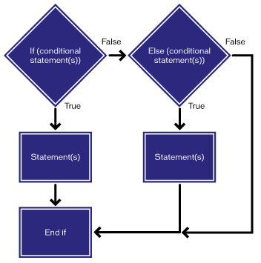
Conditional Statements

Slide 24
Question
What will the following code result in?
bool isTrue = true;
bool isFalse = false;
if (!!(!(isTrue && isFalse) || !(isTrue || isFalse)))
{
Console.WriteLine(isFalse);
}
else
{
Console.WriteLine(isTrue);
}
false
True
true
False
Compilation error
Runtime error
None of the answers

Slide 25

Question
What will the following code result in?
The case value must be a constant
int i = 1;
int j = 1;
switch (i)
{
case 1:
i = 1;
break;
case j:
i = 2;
break;
case i:
i = 3;
break;
default:
i = 4;
break;
}
Console.WriteLine(i);
1
2
3
4
Compilation error
Run-time error
None of the answers

Slide 26
Question
What will the following code result in?
int number = 5;
if (number++ == ++number)
{
Console.WriteLine(number + 1);
}
else
{
Console.WriteLine(number + 2);
}
5
6
7
8
9
10
Compilation error
Run-time error

Slide 27
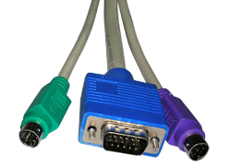
Question
What will the following code result in?
int? number = new int?();
switch (number)
{
case 1: Console.Write(1); break;
case 2: Console.Write(2); break;
case 3: Console.Write(3); break;
case null: Console.Write(4); break;
default: Console.Write(5); break;
}
1
2
3
4
Compilation error
Run-time error
None of the answers

Slide 28
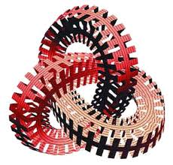
Loops

Slide 29
Question
What will the following code result in?
int count = 0;
for (int i = 1, j = 2; i < j; i++, j++)
{
count++;
if (i == 3) i++; break;
}
Console.WriteLine(count);
0
1
2
3
4
Compilation error
Run-time error
Endless loop

Slide 30

Question
What will be printed on the console when the following code is executed?
ab12
12ab
abab1212
ab12ab12
12ab12ab
Endless loop
Run-time error
Compilation error
string[] elements = { "ab", "12" };
foreach (var e in elements)
{
foreach (var ch in e)
{
Console.Write(ch);
}
Console.Write(e);
}

Slide 31
Question
What will the following code result in?
int n = 4, f = 0;
do
{
f *= n;
n--;
}
while (n > 0);
Console.WriteLine(f);
0
4
6
12
24
120
Compilation error
Run-time error
Endless loop

Slide 32

Question
What will the following code result in?
for (int i = 1; i <= 4; i = i * 2)
{
Console.Write(i + " ");
}
1 2
2 4 6
2 4 8
1 2 3
1 2 3 4
1 2 4
Compilation error
Run-time error
Endless loop

Slide 33
Question
What will the following code result in?
int sum = 0;
while (sum < 10)
for (int i = 0; i <= 2; i++)
sum += i;
Console.WriteLine(sum);
0
9
10
11
12
Compilation error
Run-time error
Endless loop

Slide 34

Question
*** Try your luck! What will be written on the console when the following code is executed?
int toto = 1;
for (int i = 2; i <= 4; i++, toto++)
{
for (int j = i - 1; j < i + 1; j += 2, toto += i < j ? 1 : -1)
{
toto <<= 2;
}
}
Console.WriteLine(toto - 57);
-49
-42
-35
5
6
35
42
49

Slide 35
C# Test Preparation
http://academy.telerik.com

